Slide 1

Exploring the Efficacy of NAO Robot as a Language Instructor: A Comparative Study
PRESENTED TO | Dr. Lafifa Jamal Professor, Dept. of Robotics & Mechatronics Engineering, University of Dhaka Shifat-E-Arman Bhuiyan Lecturer, Dept. of Robotics & Mechatronics Engineering, University of Dhaka
PRESENTED BY | Humayra Rashid Roll: SK-092-011 Ipshita Ahmed Moon Roll: SK-092-017 Safayat Hasan Roll: SH-092-021

Slide 2
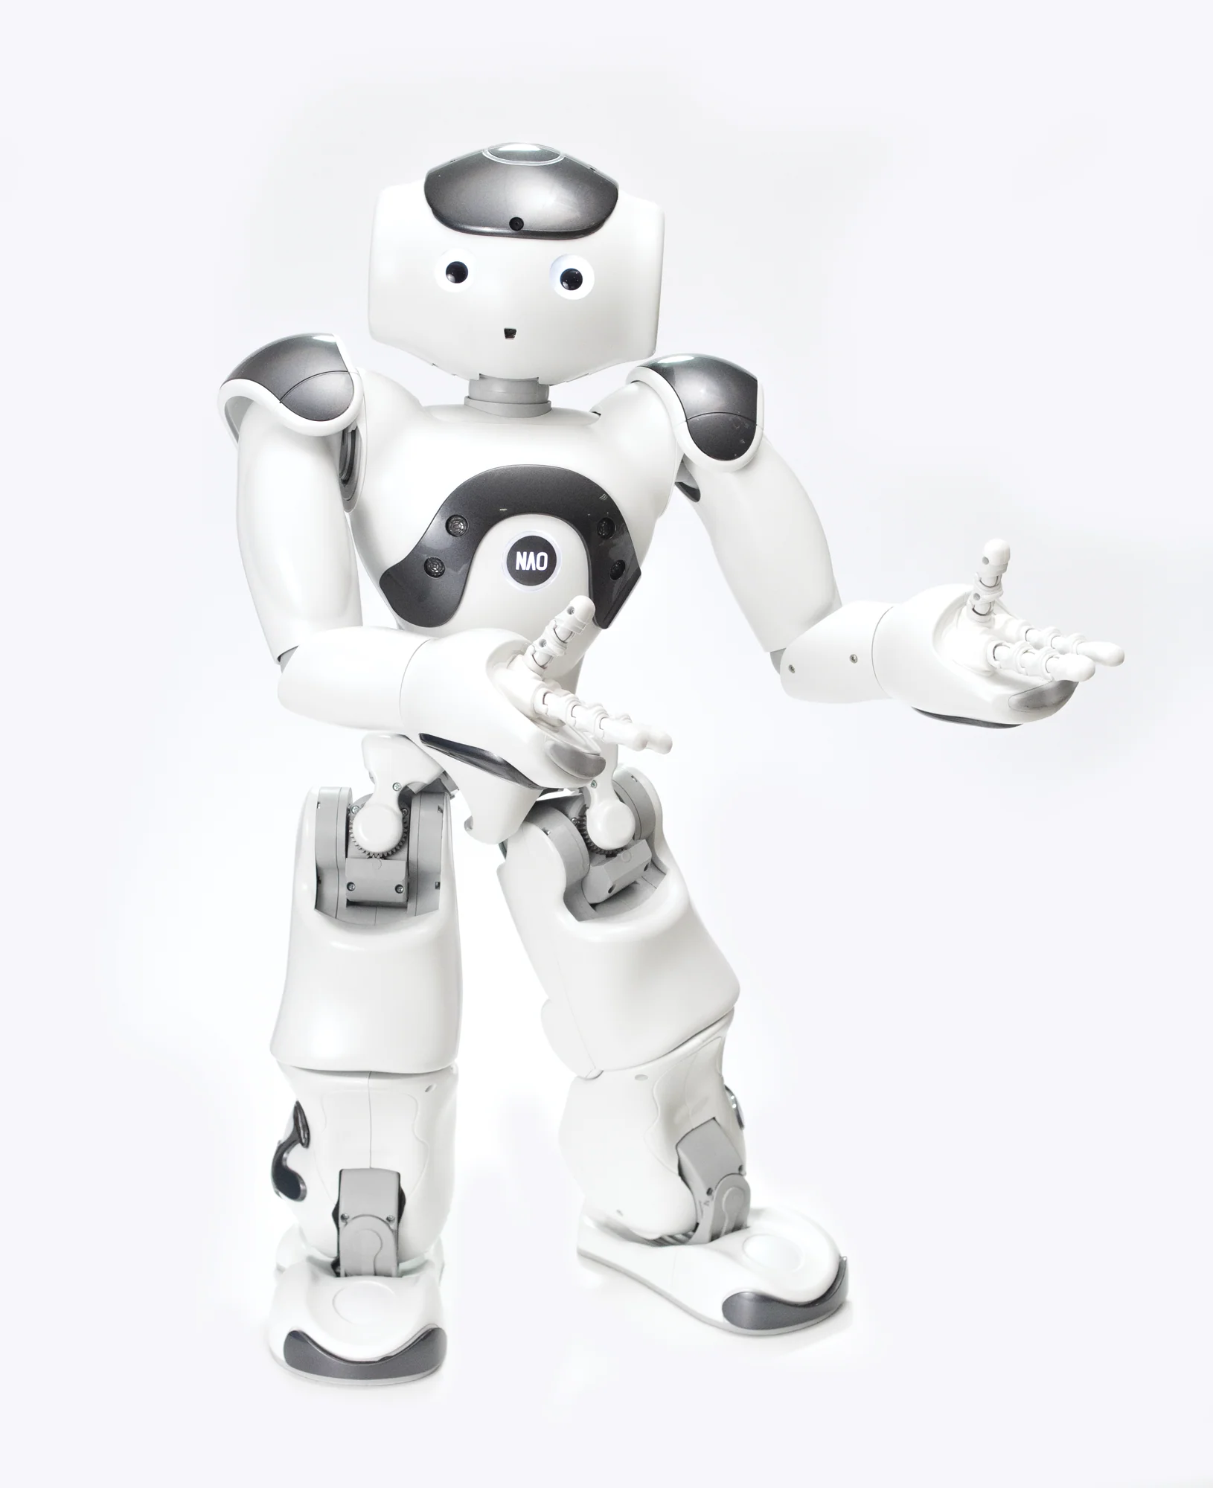
Contents
Introduction
Literature Review
Problem Statement
Methodology
Result
Discussion & Conclusion

Slide 3
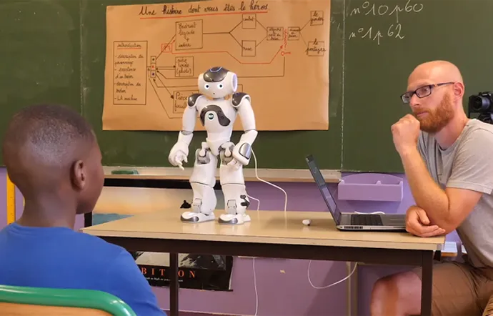
Background of the Study
Educational Robots[1]
These robots are utilized in supporting the learning of second languages[1]
Humanoid robots offer the advantage of engaging students through interactive experiences
Application of HRI in educational settings
[1] N. M. Quintero, “University language instructors programming robotic learning applications,” People, 2023

Slide 4

RELATED
Works

Slide 5
Influence of the NAO robot as a teaching assistant on university students’ vocabulary learning and attitudes [2]
NAO as teaching assistant
Subject - University students
Mixed method approach- quantitative and qualitative data
Pre-test and post-test
Attitude analysis
[2] H. Banaeian and I. Gilanlioglu, “Influence of the nao robot as a teach- ing assistant on university students’ vocabulary learning and attitudes,” Australasian Journal of Educational Technology, vol. 37, no. 3, pp. 71–87, 2021

Slide 6
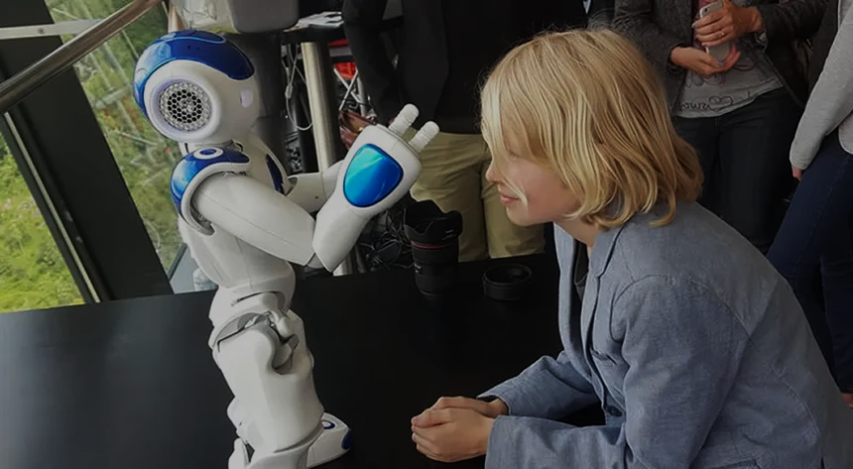
Scope of the study Drawing comparison between NAO robot and a language learning app as a second language instructor
Research Questions Could a robot as an instructor aid students’ vocabulary learning? How does the language acquisition with NAO robot vary compared to learning from app? What are the differences in the learning experiences, engagement levels and effectiveness among participants in the two learning groups? Can we identify any significant variations in learning curves over time for participants taught by the NAO robot and learning app?
Problem Statement

Slide 7
Methodology
1
2
3
Works already done
Design of the system
Expected works

Slide 8
Working Process
Pre-test on the learnable words(35 words)
Teaching Session (2 Days)
Post test based on the sessions
Analysis based on the post test data
Teaching with NAO Robot
Teaching with Language Learning App
Teaching with Human Instructor

Slide 9
1
Pre-test question is finalized based on initial selection of japanese words.
2
The design of full learning session focused on japanese vocabulary learning has been created.
Completed Works
3
The programming based on the design of full learning session has been done.
4
The questionnaire has been finalized for taking the feedback from the participants.

Slide 10



General Functionality
NAO robot will greet the students and explain what is purpose of the session
A japanese word along with the spelling and picture will appear on the the screen kept behind NAO robot
Screen
NAO
NAO robot will teach the pronunciation and meaning of the word to the students
Students
Figure 1. NAO robot teaching the students Japanese vocabulary.

Slide 11
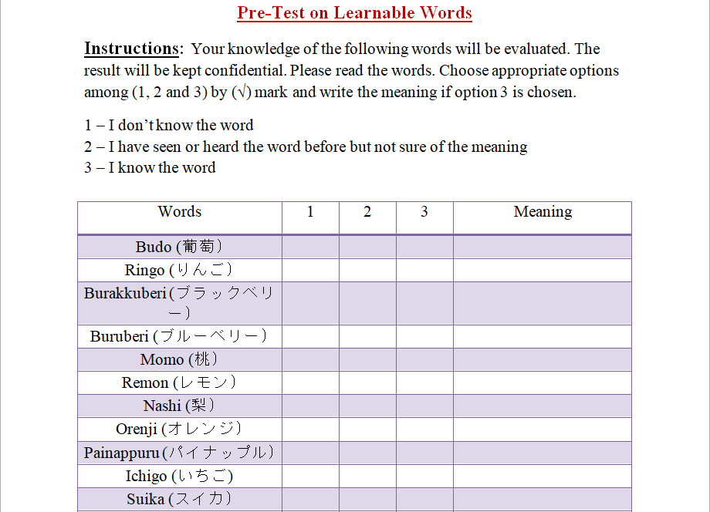
Pre-test Question

Slide 12
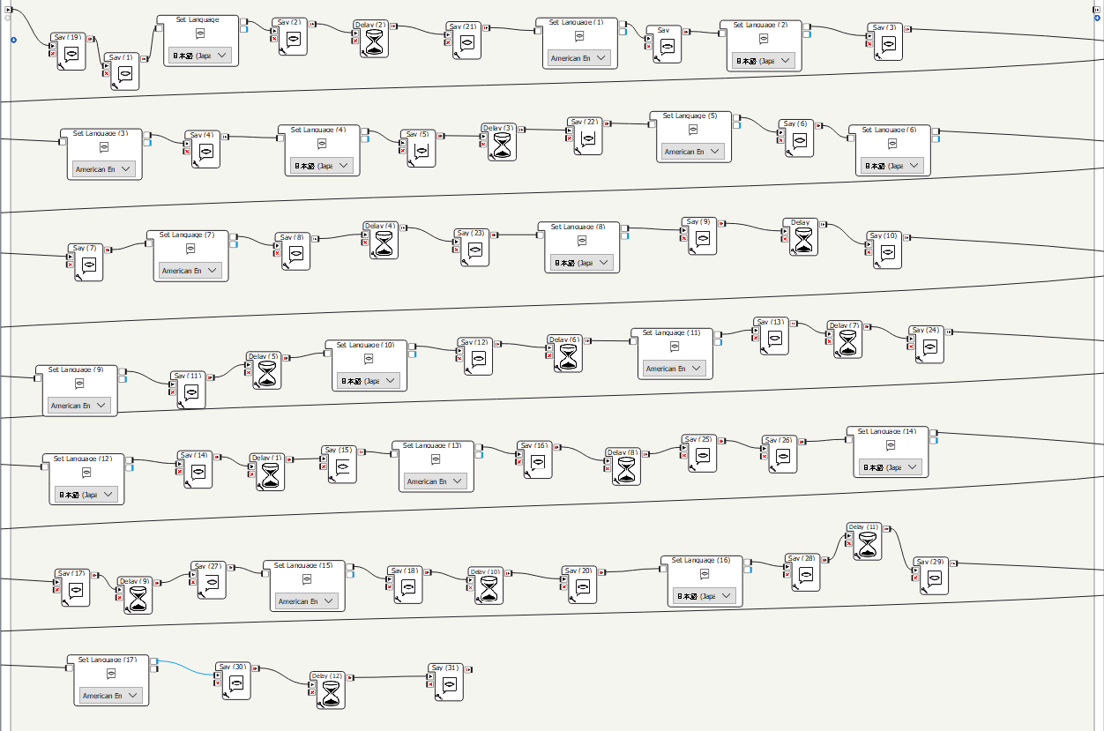
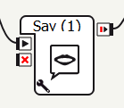
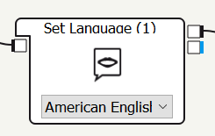
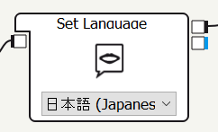
Figure 2. NAO robot programme in choregraphe software

Slide 13
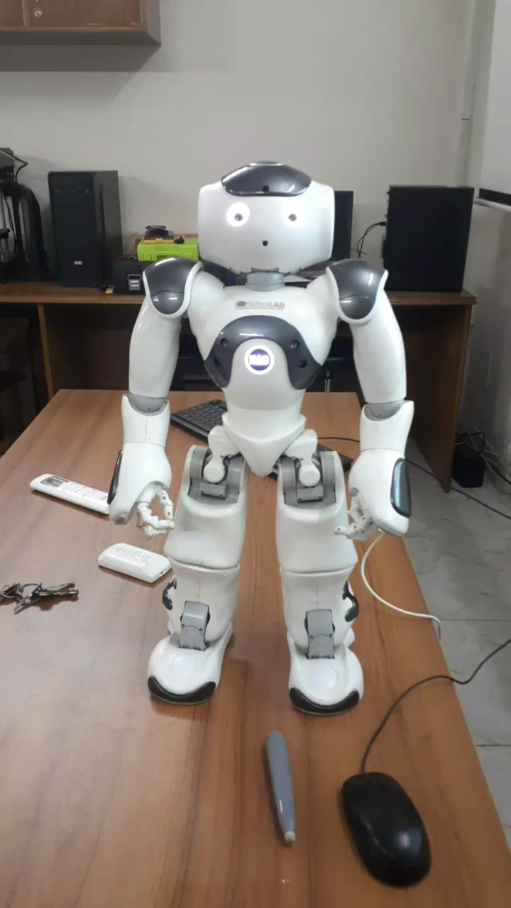
Demo Session By NAO
NAO robot is greeting the participants

Slide 14
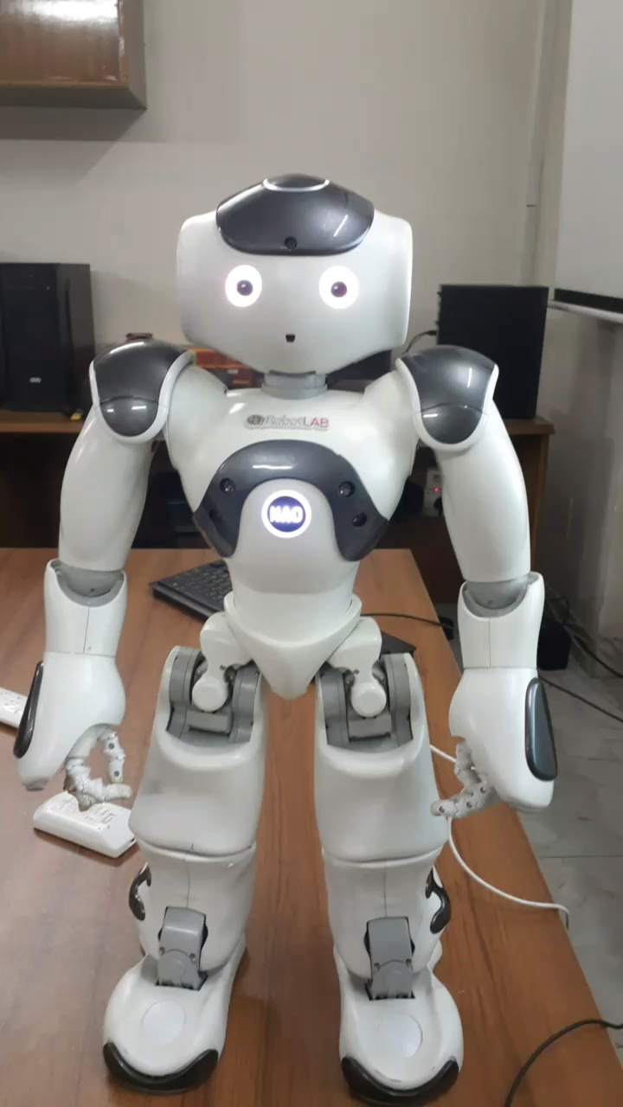
Demo Session By NAO
NAO robot is teaching the words one by one

Slide 15
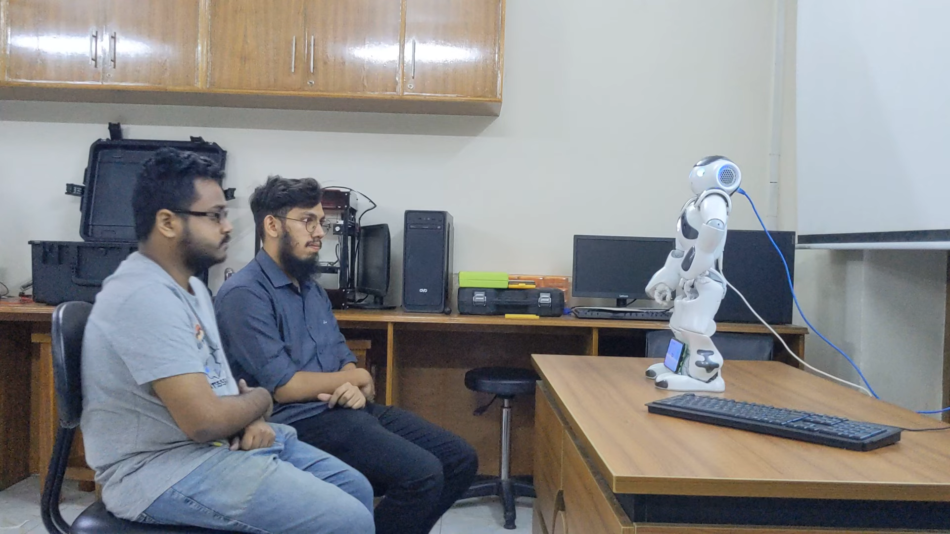
Demo Session By NAO
NAO robot is teaching the words one by one

Slide 16
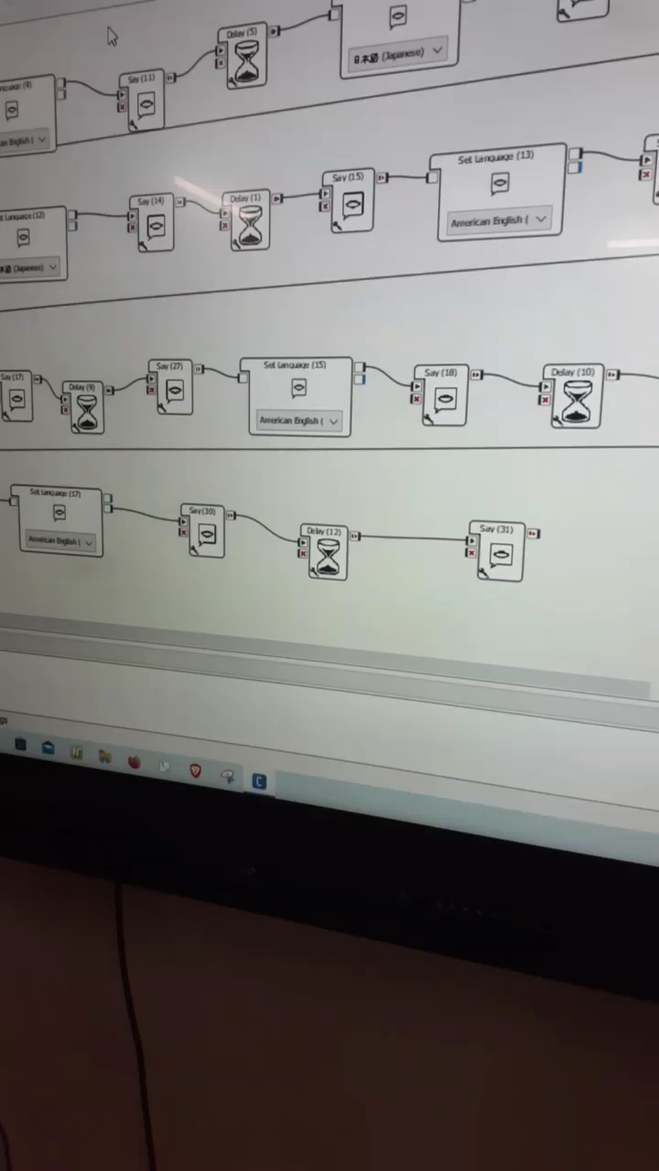
Demo Session By NAO
Short break after teaching 5-6 words

Slide 17
Expected
Works
Final evaluation by result analysis
Teaching by Tutor
Teaching by App
Teaching by NAO
Eliminating known words
Pre-test of the learnable words | Teaching the students new words |  | Evaluation

Slide 18
Pre-test of the Learnable Words
The Japanese words from the word list will be set as a short question paper
If the students know the word, then it will be deducted from the word list
Finalization of the word list

Slide 19
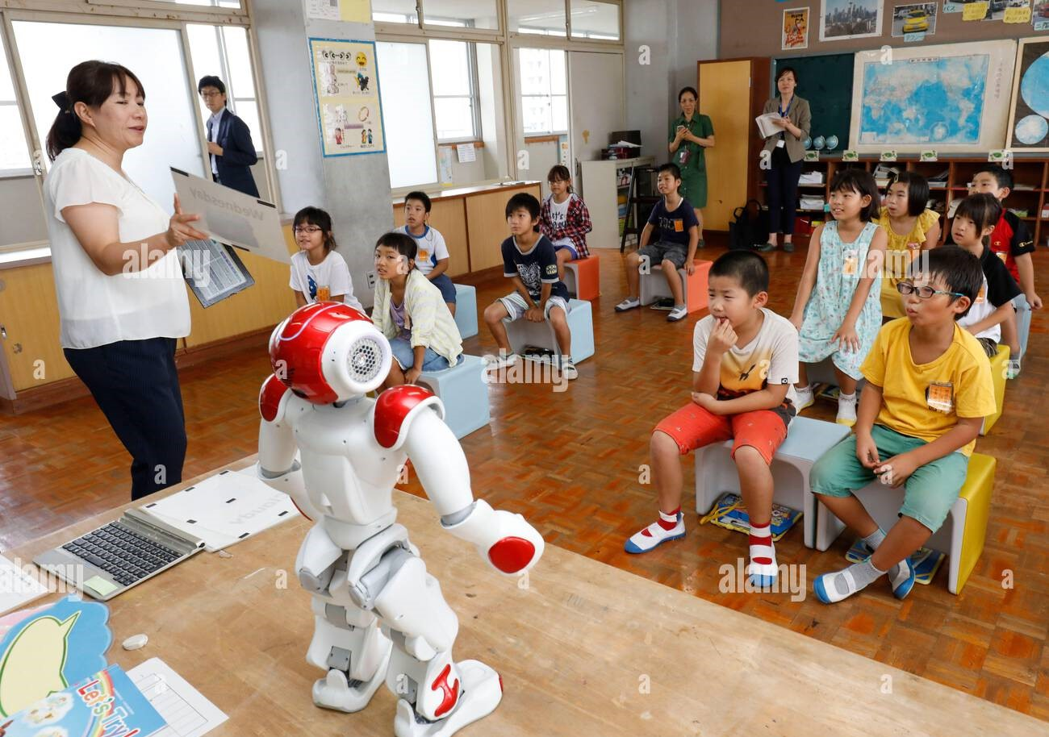
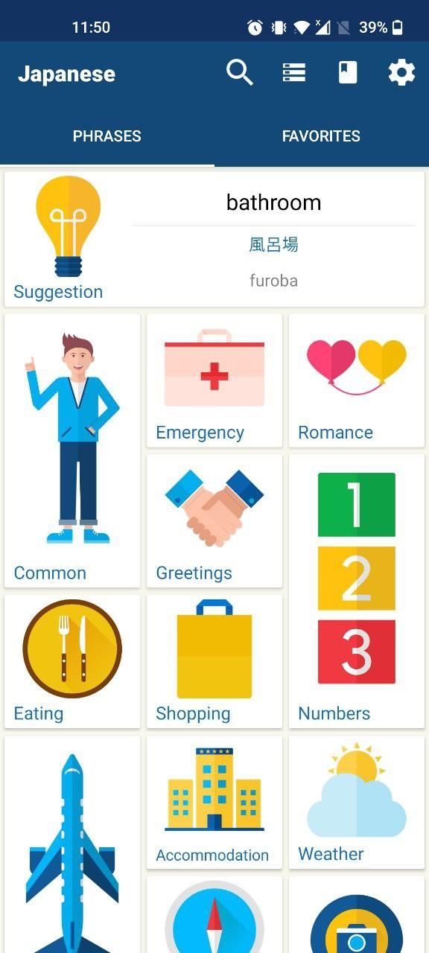

Teaching new words
The students will learn the new Japanese words in three groups
Learning by NAO
Learning by “Learn Japanese Phrases”
Learning by human instructor
[3]https://www.alamy.com/a-humanoid-robot-nao-is-pictured-at-meiji-elementary-school-in-omuta-city-fukuoka-prefecture-on-september-12-2018-using-robot-and-ai-as-the-english-teacher-at-elementary-schools-are-spreading-in-japan-58-centimeter-tall-nao-speaks-programed-words-that-teachers-operate-using-a-tablet-terminal-it-is-a-demonstration-test-of-next-guidelines-for-the-course-of-study-that-is-planned-to-expand-english-learning-the-yomiuri-shimbun-via-ap-images-image531922904.html
[4]https://play.google.com/store/apps/details?id=com.bravolang.japanese&hl=en_US
[5]https://www.ecc-nihongo.com/en/archives/onlinecourse/%e6%97%a5%e6%9c%ac%e8%aa%9e%e6%95%99%e3%81%88%e6%96%b9%e3%82%b3%e3%83%bc%e3%82%b9

Slide 20

Results

Slide 21
Discussion & Conclusion
Limitations
Limited target words
Measurement of the effectiveness may appear challenging
No guaranteed distraction free learning environment
Future Works
Option for free movement or gesture of robot can be added
The session can be made more interactive

Slide 22
Discussion & Conclusion
References
N. M. Quintero, “University language instructors programming robotic learning applications,” People, 2023
H. Banaeian and I. Gilanlioglu, “Influence of the nao robot as a teach- ing assistant on university students’ vocabulary learning and attitudes,” Australasian Journal of Educational Technology, vol. 37, no. 3, pp. 71–87, 2021
https://www.alamy.com/a-humanoid-robot-nao-is-pictured-at-meiji-elementary-school-in-omuta-city-fukuoka-prefecture-on-september-12-2018-using-robot-and-ai-as-the-english-teacher-at-elementary-schools-are-spreading-in-japan-58-centimeter-tall-nao-speaks-programed-words-that-teachers-operate-using-a-tablet-terminal-it-is-a-demonstration-test-of-next-guidelines-for-the-course-of-study-that-is-planned-to-expand-english-learning-the-yomiuri-shimbun-via-ap-images-image531922904.html
https://play.google.com/store/apps/details?id=com.bravolang.japanese&hl=en_US
https://www.ecc-nihongo.com/en/archives/onlinecourse/%e6%97%a5%e6%9c%ac%e8%aa%9e%e6%95%99%e3%81%88%e6%96%b9%e3%82%b3%e3%83%bc%e3%82%b9
Limitations
Real image data appeared turncated
Difficulty in reconstruction of image
Long time required for first time setup
Light source, camera angles severely affected the result
Future Works
The system can be made easier to use and deploy
Option of free movement of robot can be added
Facial expression and speech can be combined
More in depth evaluation

Slide 23
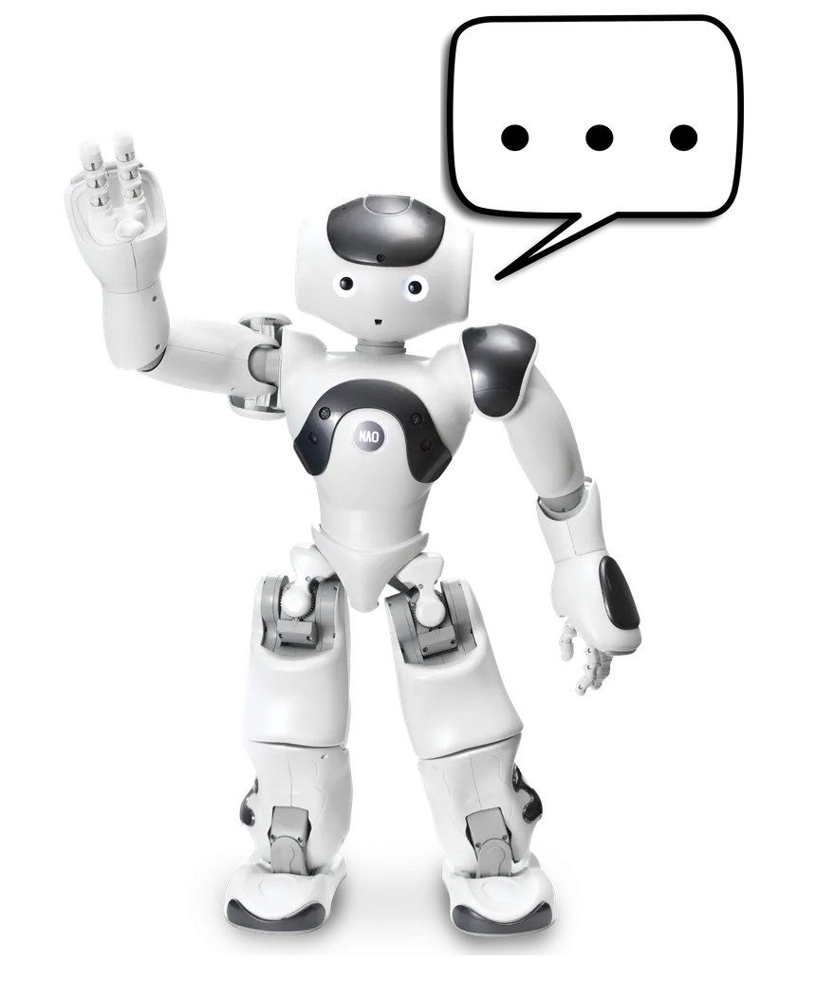
Thank
You!

